Slide 1







Step Up Data Science & AI Challenge
CAN WE TRUST THE RIDE?
When Autonomous Vehicles Take the Drive
University and Higher Education students
Powered by

Slide 2

Your challenge resources
Use the deck, CSV pack, how-to guide and client setup video to complete the challenge.
Challenge deck
CSV dataset pack
The scenario, mission and trust question.
Six CSV files plus a README, including 2,500 synthetic journeys.
How-to guide + video
Your final output
Follow the Python steps; watch the video to set up Colab.
4–6 slides: charts, model results and your trust recommendation.
Recommended: Python in Colab. Save your notebook regularly and keep a downloaded copy.

Slide 3
What will you learn?
Build practical coding, modelling and AI decision-making skills used in transport careers.
Explore linked data
Code with confidence
Analyse 2,500 vehicle journeys.
Load, join, clean and visualise data.
Investigate performance
Think like an AI scientist
Find patterns and predict problems.
Evaluate models, bias and limitations.

Slide 4

How does an autonomous vehicle decide?
There is no driver behind the wheel. Sensors, data and artificial intelligence guide every action.
1. Sensors perceive roads, objects, weather and movement
2. AI interprets the situation and selects an action
3. The vehicle steers, slows, stops or requests intervention
4. Journey data records performance, alerts and safety outcomes
Trust must be tested with evidence across different conditions.

Slide 5
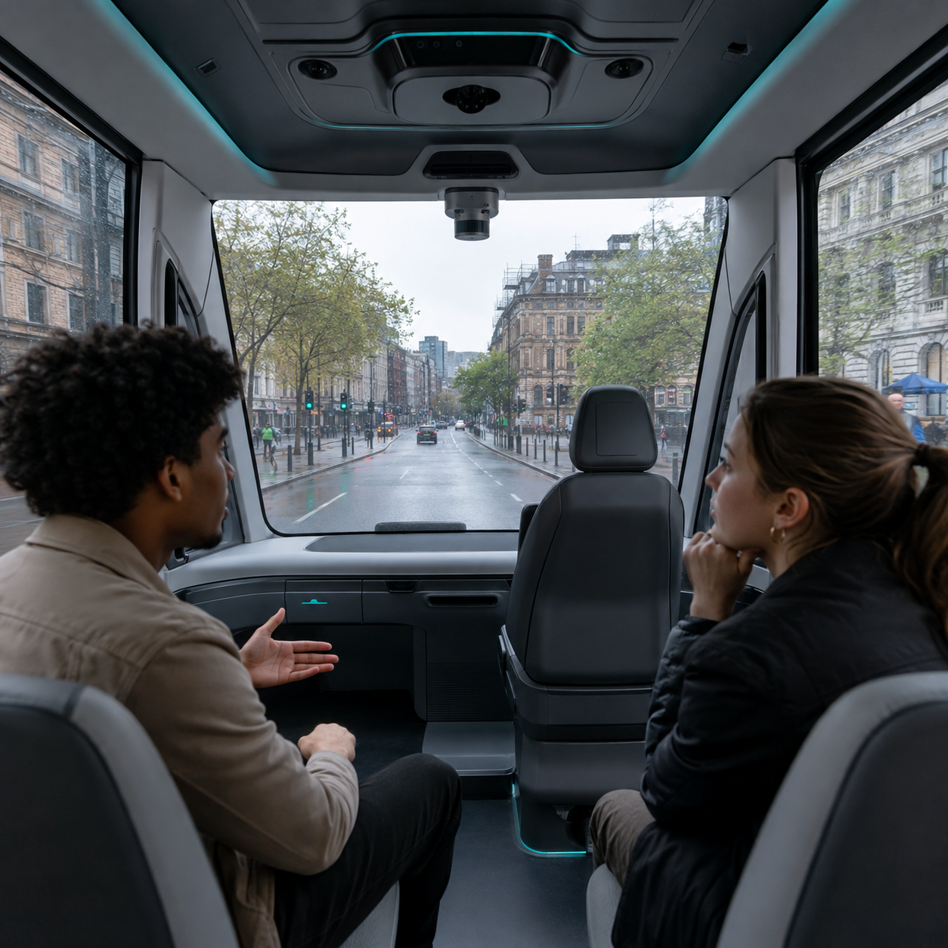
Start with the trust question
You book an autonomous vehicle for an important journey. What would concern you most?
A Poor visibility or severe weather
B Low sensor confidence or repeated alerts
C A human intervention or emergency stop
D A risk the dataset does not capture
Think like a passenger and an AI transport scientist. First decide what evidence matters.

Slide 6

Your challenge as an AI Transport Scientist
Can the autonomous vehicle be trusted?
Understand the journey
Every journey links vehicle performance to sensors, roads, weather, traffic and operating conditions.
Investigate the patterns
Use programming and data science to find patterns, measure risk factors and predict when problems may occur.
Make your recommendation
Explain how AI could improve future journeys, then make your trust decision.
A high success rate may still hide important conditions, risks and limitations.

Slide 7
What should your trust decision balance?
Use the linked datasets to test four connected questions.
Can you find hidden patterns?
Which factors matter most?
Which combinations of conditions are linked with problems or interventions?
Explore: grouped summaries and charts.
Watch out: correlation does not prove cause.
How do weather, traffic, road type and sensor confidence affect outcomes?
Compare: rates, distributions and features.
Watch out: association is not causation.
Can you predict a problem?
How could AI improve journeys?
Train a transparent model to predict problem_occurred before a journey ends.
Model: logistic regression or decision tree.
Watch out: accuracy alone can mislead.
Could better sensing, warnings or training data reduce risk?
Explain: evidence, limits and action.
Watch out: the data is synthetic and observational.
The strongest decision combines patterns, prediction quality, safety, ethics and operating conditions.

Slide 8
Your mission
Use the linked datasets to answer five questions.
1. Can you identify patterns that humans might miss?
2. Which factors have the biggest impact on performance?
Bonus question
3. Can you predict when problems might occur?
What ethical risks should we address?
4. How could AI improve future journeys?
5. Based on the evidence, would you trust the ride?

Slide 9
Data dictionary
Each row is one synthetic autonomous-vehicle journey. The main file contains 2,500 rows.
Road type
Operating environment
Dataset snippet
Vehicle profile
Sensor-system join key
Four records from autonomous_vehicle_journeys.csv
Sensor confidence
Confidence percentage
ID
Road
City
Conf%
Issue?
Weather
Problem occurred
Beginner model target
00001
B road
Newcastle
87.6
No
Low sun
Risk level
Low, Medium or High
00002
Urban
Cardiff
93.5
No
Clear
Journey completed
Destination reached
00003
A road
Cardiff
65.9
Yes
Snow
Delay
Actual minus planned time
00004
Motorway
Cardiff
82.0
No
Light rain
Start with data types and distributions. Then join supporting files before modelling or drawing conclusions.

Slide 10
Step 1: load, check and join the data
Follow the setup video and how-to guide. Use the exact CSV filenames in your code.
1 Unzip the pack
All seven files in your data pack
Keep all seven files together
File | Rows | Join key / purpose
autonomous_vehicle_journeys.csv | 2,500 | Main: journey_id
vehicle_sensor_profiles.csv | 10 | vehicle_profile_id
road_environment_factors.csv | 30 | road_segment_id
weather_risk_factors.csv | 8 | weather_code
intervention_events.csv | 377 | journey_id (event analysis)
data_dictionary.csv | 25 | Field definitions
README.txt | — | Read first: pack instructions
2 Set up Colab
Create a notebook and connect
3 Upload all six CSVs
Use the Files panel, then load
4 Check and join
Run guide code in order; save
Save your notebook and download a copy. If the runtime resets, re-upload CSVs and rerun cells.
Notes:
[Sources]
- https://colab.google/ (official Google Colab)
- https://jupyter.org/install (official Jupyter installation guidance)
- https://posit.co/downloads (official RStudio download page)

Slide 11
Step 2: explore patterns before modelling
Turn 2,500 journeys into summaries and charts that reveal when attention may be needed.
Group and compare
Calculate problem rates by weather, traffic and road type. Compare distributions, not only averages.
Visualise it
Use bar charts, box plots or heatmaps. Investigate low-confidence journeys and unexpected obstacles.
Example insight: problems rise from 15.7% in clear weather to 47.7% in snow. This is association, not proof of cause.
Notes:
[Sources]
- Project_Route_Step_Up_Data_Science_AI_Datasets.zip — autonomous_vehicle_journeys.csv (synthetic teaching data; problem rates calculated from the supplied records)

Slide 12
Step 3: build and evaluate a simple model
Use an 80/20 train–test split and compare model predictions with outcomes the model has not seen.
Example logistic regression: 94.4% accuracy and 98.0% recall. Explain false alarms, missed problems and possible data leakage.
Notes:
[Sources]
- Project_Route_Step_Up_Data_Science_AI_Datasets.zip — autonomous_vehicle_journeys.csv (synthetic teaching data)
- Example model: logistic regression using an 80/20 stratified split; pre-outcome predictors only. Results may vary with implementation and random seed.

Slide 13
Build an evidence portfolio that supports your decision
Use charts, model results and short evidence statements to build your case.
What patterns did you find?
How well did the model work?
Show two strong comparisons and explain what they mean.
Report accuracy, precision, recall and a confusion matrix.
Could the model be unfair?
Can people understand the decision?
Consider missing groups, unequal errors and unmeasured conditions.
Recommend explainable safeguards, human oversight and monitoring.
Every result should help explain when, and why, you would trust the ride.

Slide 14

Present your recommendation
Create a presentation of 4–6 slides, supported by your data science analysis.
Suggested content for your slides
1
Your name, university course and challenge title. Explain the patterns you found.
Introduce the challenge
2
Present your analysis
Show key factors, charts, model results and how AI could improve journeys.
3
Make your trust decision
Explain your recommendation, ethical risks, model limitations and practical action.
Your presentation should include:
Trust decision
Model evidence
Limitation
Practical action

Slide 15
Would you trust the ride?
Any Questions?

